Slide 1

Chapter 19
Network
Layer
Protocols
Copyright © The McGraw-Hill Companies, Inc. Permission required for reproduction or display.
Notes:
1

Slide 2
Chapter 4: Outline
19.1 IPv4
19.2 ICMPv4
19.3 Mobile IP
Notes:
19.#

Slide 3

Chapter 19: Objective
The first section discusses the IPv4 protocol. It first describes the IPv4 datagram format. It then explains the purpose of fragmentation in a datagram. The section then briefly discusses options fields and their purpose in a datagram. The section finally mentions some security issues in IPv4, which are addressed in Chapter 32.
The second section discusses ICMPv4, one of the auxiliary protocols used in the network layer to help IPv4. First, it briefly discusses the purpose of each option. The section then shows how ICMP can be used as a debugging tool. The section finally shows how the checksum is calculated for an ICMPv4 message.
Notes:
19.#

Slide 4
Chapter 19: Objective (continued)
The third section discusses the mobile IP, whose use is increasing every day when people temporarily move their computers from one place to another. The section first describes the issue of address change in this situation. It then shows the three phases involved in the process. The section finally explains the inefficiency involved in this process and some solutions.
Notes:
19.#

Slide 5
19.1 NETWORK-LAYER PROTOCOLS
The network layer in version 4 can be thought of as one main protocol and three auxiliary ones. The main protocol, IPv4, is responsible for packetizing, forwarding, and delivery of a packet. The ICMPv4 helps IPv4 to handle some errors that may occur in delivery. The IGMP is used to help IPv4 in multicasting. ARP is used in address mapping.
19.5
Notes:
19.#

Slide 6
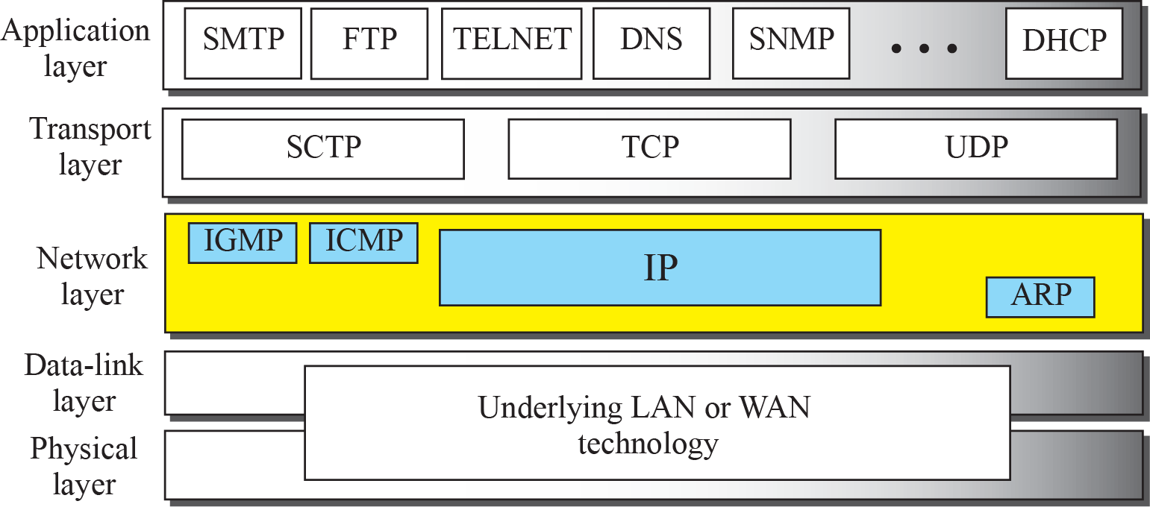
Figure 19.1: Position of IP and other network-layer protocols in
TCP/IP protocol suite
19.6
Notes:
19.#

Slide 7
19.19.1 Datagram Format
Packets used by the IP are called datagrams. Figure 19.2 shows the IPv4 datagram format. A datagram is a variable-length packet consisting of two parts: header and payload (data). The header is 20 to 60 bytes in length and contains information essential to routing and delivery. It is customary in TCP/IP to show the header in 4-byte sections..
19.7
Notes:
19.#

Slide 8
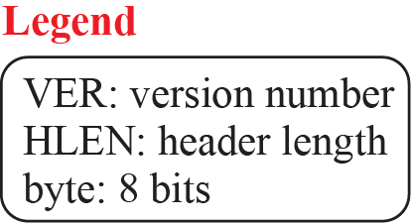
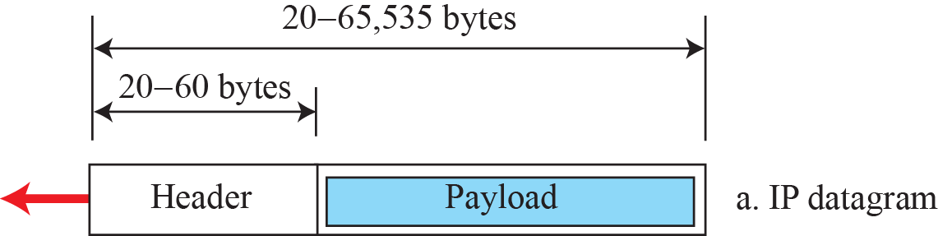
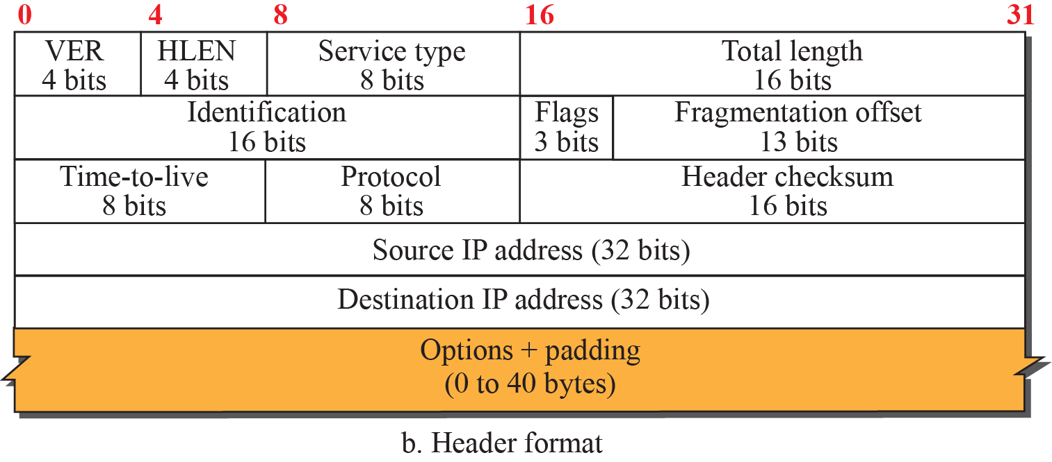
Figure 19.2: IP datagram
19.8
Notes:
19.#

Slide 9
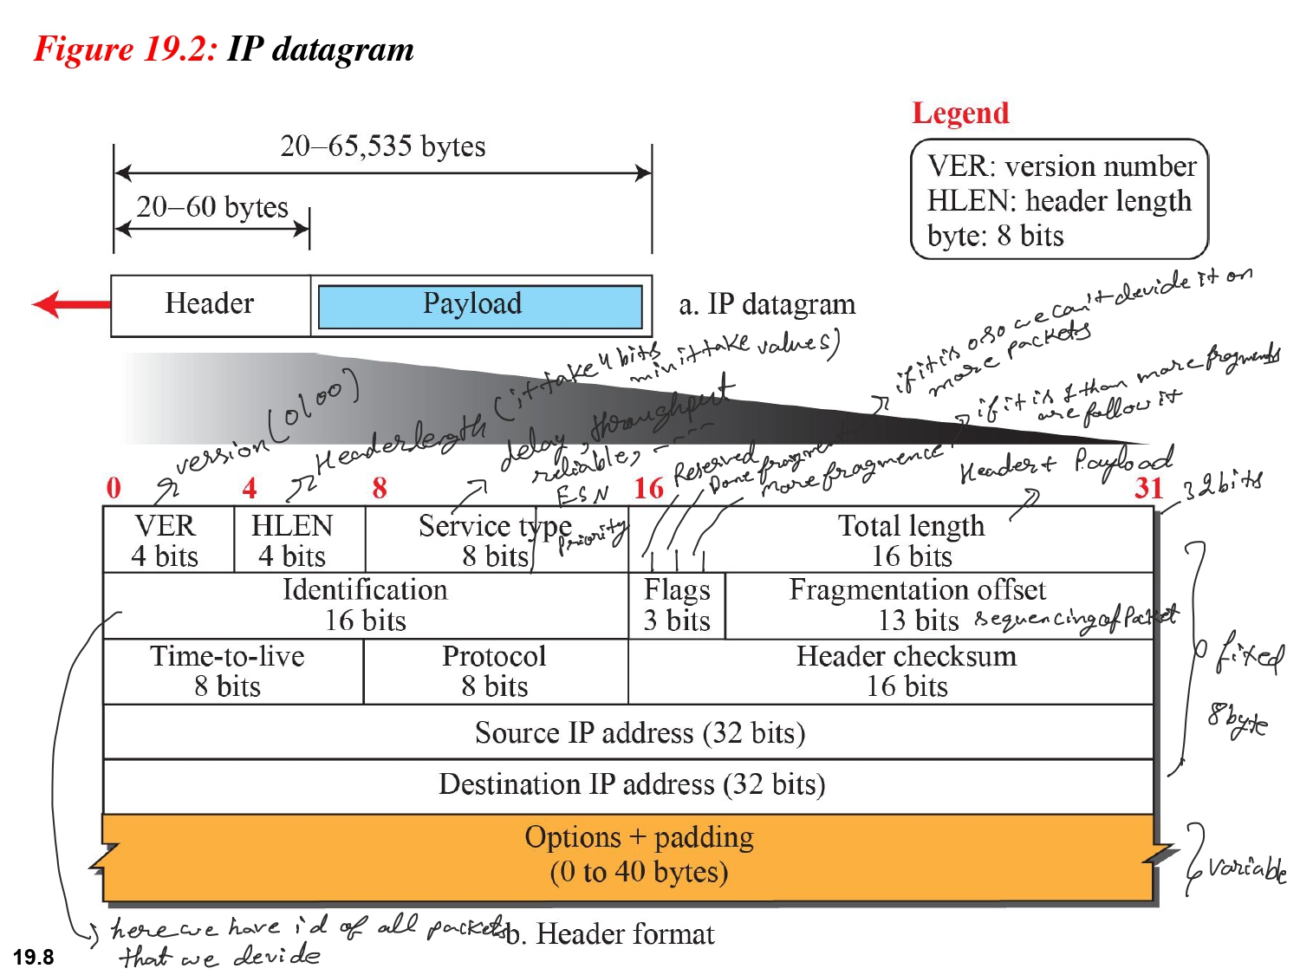

Slide 10
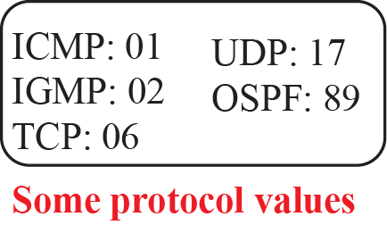
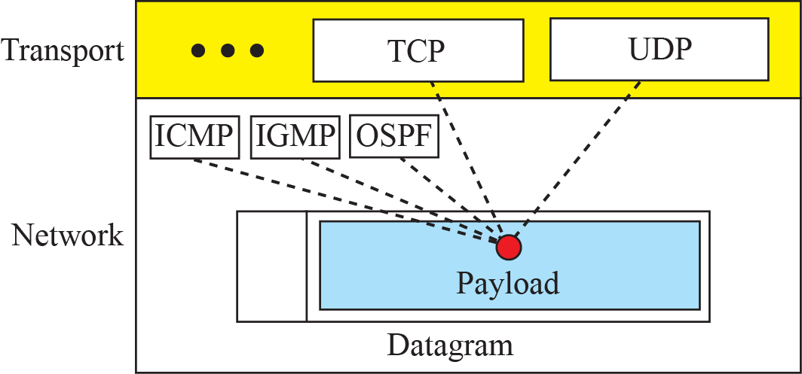
Figure 19.3: Multiplexing and demultiplexing using the value of
the protocol field
19.10
Notes:
19.#

Slide 11
Example 19.1
An IPv4 packet has arrived with the first 8 bits as (01000010)₂ The receiver discards the packet. Why?.
Solution
There is an error in this packet. The 4 leftmost bits (0100)₂ show the version, which is correct. The next 4 bits (0010)₂ show an invalid header length (2 × 4 = 8). The minimum number of bytes in the header must be 20. The packet has been corrupted in transmission.
First 4 are version next 4 value is 2 but min HLEN length is 6 so it is wrong
19.11
Notes:
11

Slide 12
Example 19.2
In an IPv4 packet, the value of HLEN is (1000)₂. How many bytes of options are being carried by this packet?
Solution
The HLEN value is 8, which means the total number of bytes in the header is 8 × 4, or 32 bytes. The first 20 bytes are the base header, the next 12 bytes are the options.
1000=8 so HLEN min length is 5 so 8-5=3
So optional is 3*4bit=12 bytes
19.12
Notes:
12

Slide 13
Example 19.3
In an IPv4 packet, the value of HLEN is 5, and the value of the total length field is (0028)₁₆. How many bytes of data are being carried by this packet?
Solution
The HLEN value is 5, which means the total number of bytes in the header is 5 × 4, or 20 bytes (no options). The total length is (0028)₁₆ or 40 bytes, which means the packet is carrying 20 bytes of data (40 − 20)=20
16¹ * 2+16⁰ * 8=32+8=40
So total length=40 bytes
19.13
Notes:
13

Slide 14
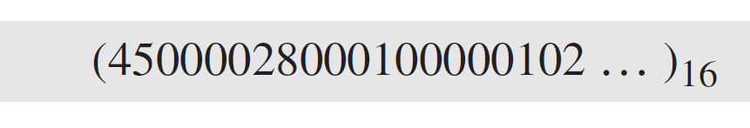
Example 19.4
An IPv4 packet has arrived with the first few hexadecimal digits as shown.
How many hops can this packet travel before being dropped? The data belong to what upper-layer protocol?
Solution
To find the time-to-live field, we skip 8 bytes (16 hexadecimal digits). The time-to-live field is the ninth byte, which is (01)₁₆. This means the packet can travel only one hop. The protocol field is the next byte (02)₁₆, which means that the upper-layer protocol is IGMP.
19.14
Notes:
14

Slide 15
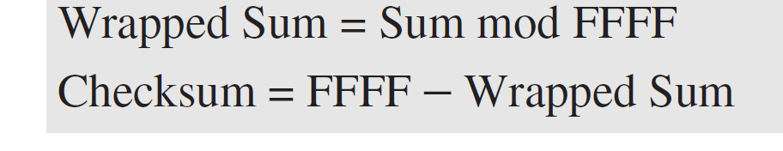
Example 19.5
Figure 19.4 shows an example of a checksum calculation for an IPv4 header without options. The header is divided into 16-bit sections. All the sections are added and the sum is complemented after wrapping the leftmost digit. The result is inserted in the checksum field.
Note that the calculation of wrapped sum and checksum can also be done as follows in hexadecimal:
19.15
Notes:
15

Slide 16
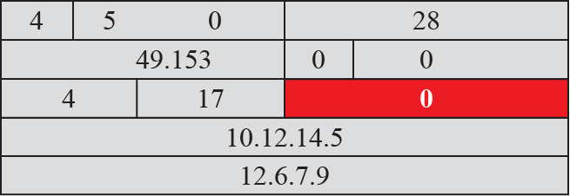

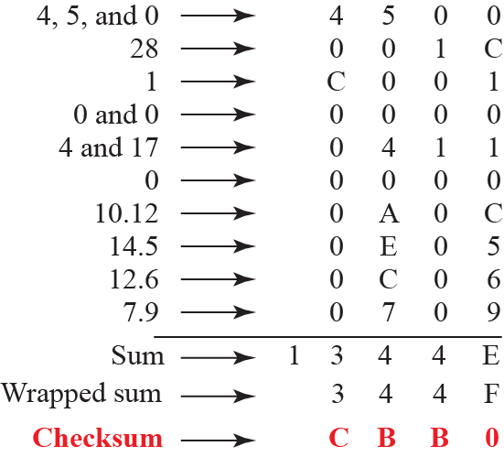
Figure 19.4:
19.16
Notes:
19.#

Slide 17
19.19.2 Fragmentation
A datagram can travel through different networks. Each router decapsulates the IP datagram from the frame it receives, processes it, and then encapsulates it in another frame. The format and size of the received frame depend on the protocol used by the physical network through which the frame has just traveled. The format and size of the sent frame depend on the protocol used by the physical network through which the frame is going to travel. For example, if a router connects a LAN to a WAN, it receives a frame in the LAN format and sends a frame in the WAN format.
19.17
Notes:
19.#

Slide 18
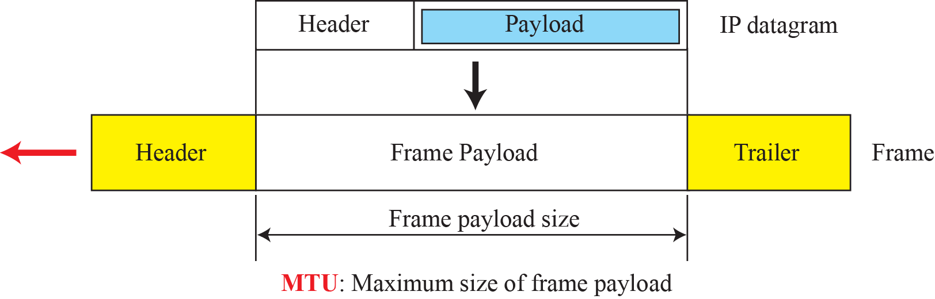
Figure 19.5: Maximum transfer unit (MTU)
19.18
Notes:
19.#

Slide 19
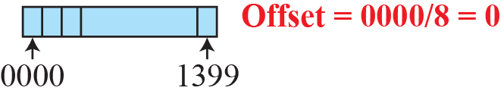
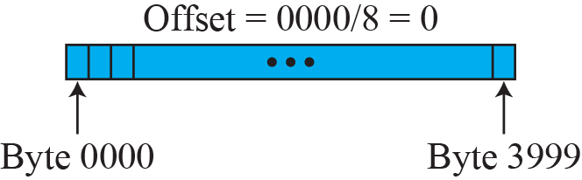
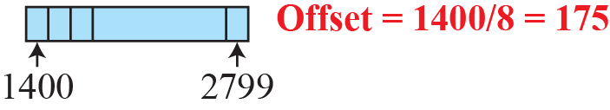
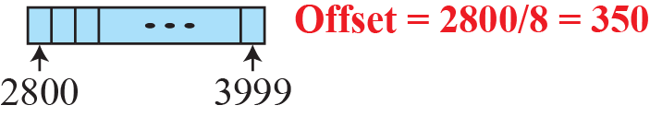
Figure 19.6: Fragmentation example
19.19
Notes:
19.#

Slide 20
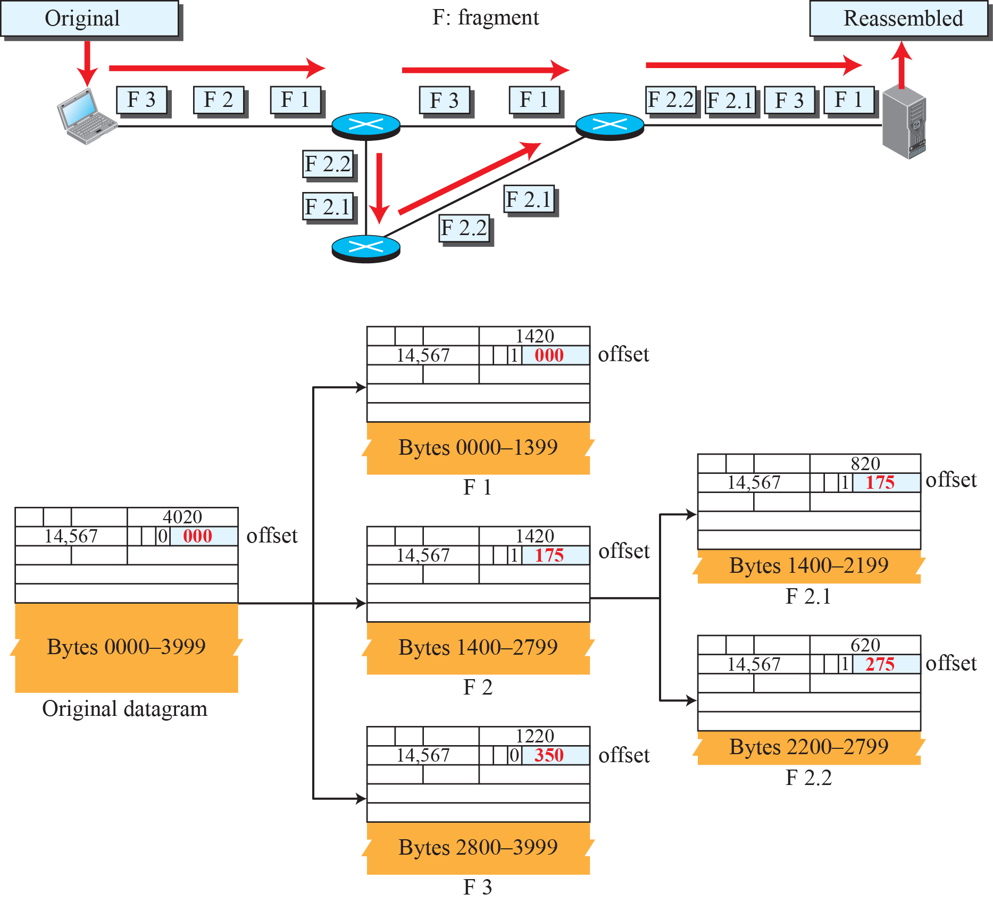
Figure 19.7: Detailed fragmentation example
It shows more packets are come after it this is
Not the last packet
19.20
This is the last packet
Notes:
19.#

Slide 21
Example 19.6
A packet has arrived with an M bit value of 0. Is this the first fragment, the last fragment, or a middle fragment? Do we know if the packet was fragmented?
Solution
If the M bit is 0, it means that there are no more fragments; the fragment is the last one. However, we cannot say if the original packet was fragmented or not. A nonfragmented packet is considered the last fragment.
19.21
Notes:
21

Slide 22
Example 19.7
A packet has arrived with an M bit value of 1. Is this the first fragment, the last fragment, or a middle fragment? Do we know if the packet was fragmented?
Solution
If the M bit is 1, it means that there is at least one more fragment. This fragment can be the first one or a middle one, but not the last one. We don’t know if it is the first one or a middle one; we need more information (the value of the fragmentation offset).
19.22
Notes:
22

Slide 23
Example 19.8
A packet has arrived with an M bit value of 1 and a fragmentation offset value of 0. Is this the first fragment, the last fragment, or a middle fragment?
Solution
Because the M bit is 1, it is either the first fragment or a middle one. Because the offset value is 0, it is the first fragment.
19.23
Notes:
23

Slide 24
Example 19.9
A packet has arrived in which the offset value is 100. What is the number of the first byte? Do we know the number of the last byte?
Solution
To find the number of the first byte, we multiply the offset value by 8. This means that the first byte number is 800. We cannot determine the number of the last byte unless we know the length of the data.
19.24
Notes:
24

Slide 25
Example 19.10
A packet has arrived in which the offset value is 100, the value of HLEN is 5, and the value of the total length field is 100. What are the numbers of the first byte and the last byte?
Solution
The first byte number is 100 × 8 = 800. The total length is 100 bytes, and the header length is 20 bytes (5 × 4), which means that there are 80 bytes in this datagram. If the first byte number is 800, the last byte number must be 879.
100-20=80
800 879 is last
19.25
Notes:
25

Slide 26
19.19.3 Options
The header of the IPv4 datagram is made of two parts: a fixed part and a variable part. The fixed part is 20 bytes long and was discussed in the previous section. The variable part comprises the options that can be a maximum of 40 bytes (in multiples of 4-bytes) to preserve the boundary of the header.
19.26
Notes:
19.#

Slide 27
19.19.4 Security of IPv4 Datagrams
The IPv4 protocol, as well as the whole Internet, was started when the Internet users trusted each other. No security was provided for the IPv4 protocol. Today, however, the situation is different; the Internet is not secure anymore. Although we will discuss network security in general and IP security in particular in Chapters 31 and 32, here we give a brief idea about the security issues in IP protocol and the solutions. There are three security issues that are particularly applicable to the IP protocol: packet sniffing, packet modification, and IP spoofing.
19.27
Notes:
19.#

Slide 28
19.2 ICMPv4
The IPv4 has no error-reporting or error-correcting mechanism. The IP protocol also lacks a mechanism for host and management queries. The Internet Control Message Protocol version 4 (ICMPv4) has been designed to compensate for the above two deficiencies.
19.28
Notes:
19.#

Slide 29
19.2.1 MESSAGES
ICMP messages are divided into two broad categories: error-reporting messages and query messages. The error-reporting messages report problems that a router or a host (destination) may encounter when it processes an IP packet. The query messages, which occur in pairs, help a host or a network manager get specific information from a router or another host. For example, nodes can discover their neighbors. Also, hosts can discover and learn about routers on their network and routers can help a node redirect its messages.
19.29
Notes:
19.#

Slide 30
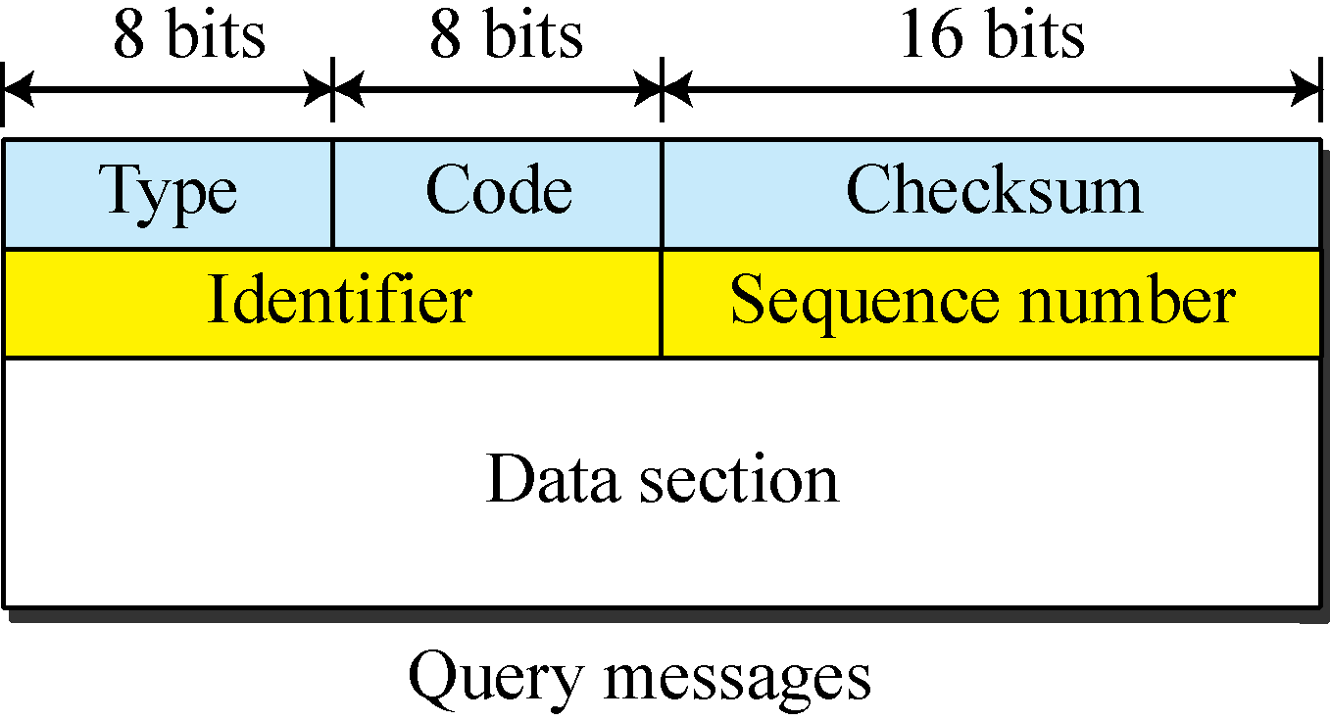
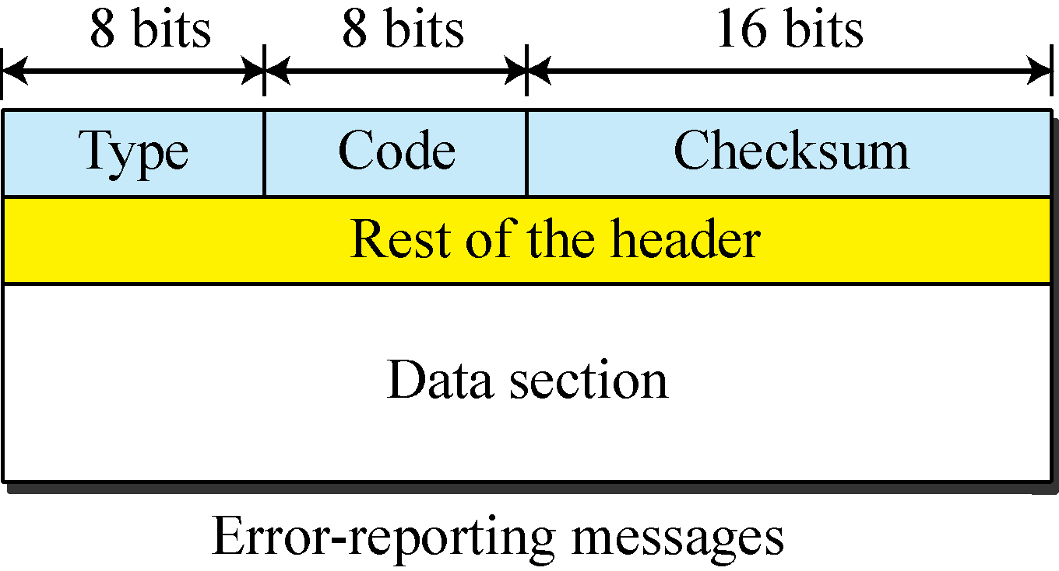
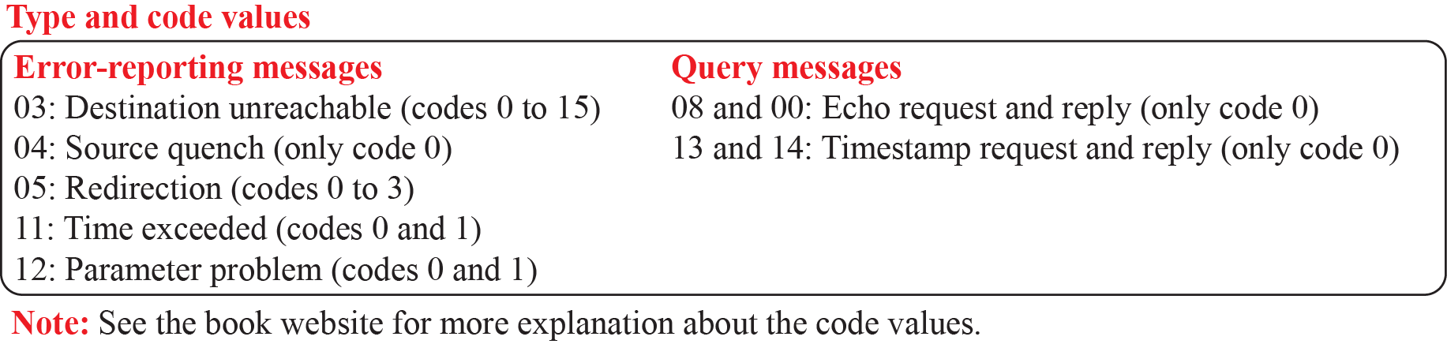
Figure 19.8: General format of ICMP messages
19.30
Notes:
19.#

Slide 31
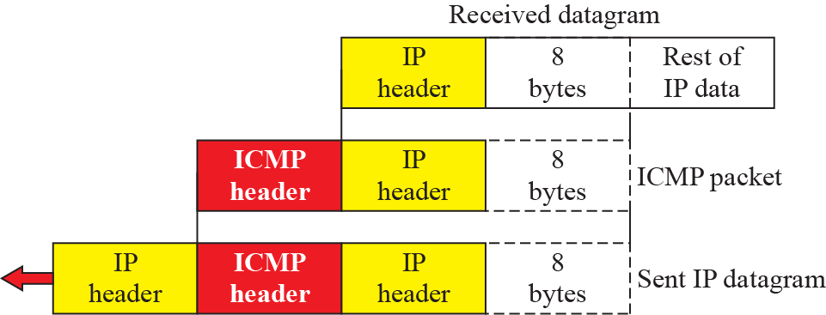
Figure 19.9: Contents of data field for the error messages
When router show error it send feedback to the sender by send whole packet back
to the sender
19.31
Notes:
19.#

Slide 32
19.2.2 Debugging Tools
There are several tools that can be used in the Internet for debugging. We can determine the viability of a host or router. We can trace the route of a packet. We introduce two tools that use ICMP for debugging: ping and traceroute.
19.32
Notes:
19.#

Slide 33
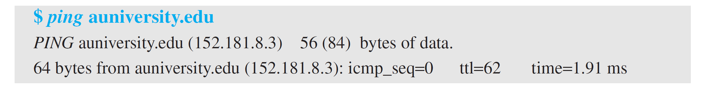
Example 19.11
The following shows how we send a ping message to the auniversity.edu site. We set the identifier field in the echo request and reply message and start the sequence number from 0; this number is incremented by one each time a new message is sent. Note that ping can calculate the round-trip time. It inserts the sending time in the data section of the message. When the packet arrives, it subtracts the arrival time from the departure time to get the round-trip time (rtt).
19.33
Notes:
33

Slide 34
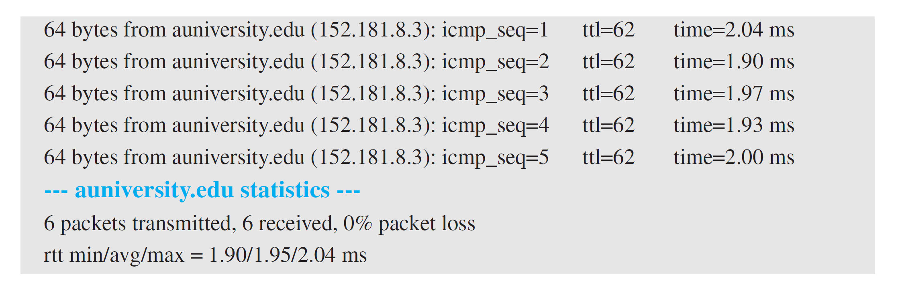
Example 19.11(continued)
19.34
Notes:
34

Slide 35
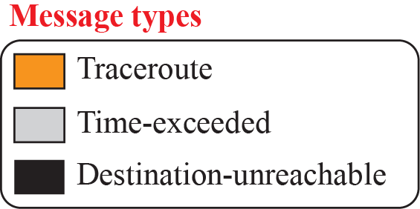
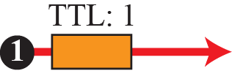


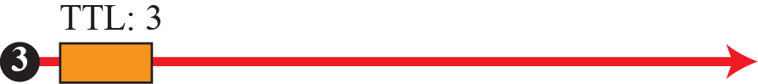
Figure 19.10: Example of traceroute program
19.35
Notes:
19.#

Slide 36
19.2.3 ICMP Checksum
In ICMP the checksum is calculated over the entire message (header and data).
19.36
Notes:
19.#

Slide 37
Example 19.12
Figure 19.11 shows an example of checksum calculation for a simple echo-request message. We randomly chose the identifier to be 1 and the sequence number to be 9. The message is divided into 16-bit (2-byte) words. The words are added and the sum is complemented. Now the sender can put this value in the checksum field.
19.37
Notes:
37

Slide 38
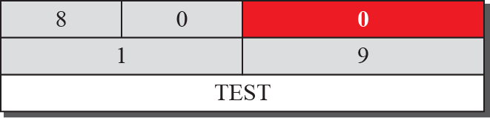
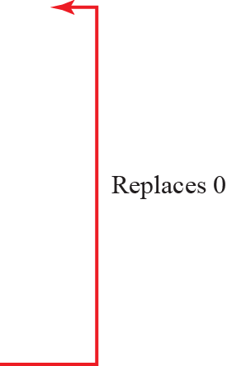
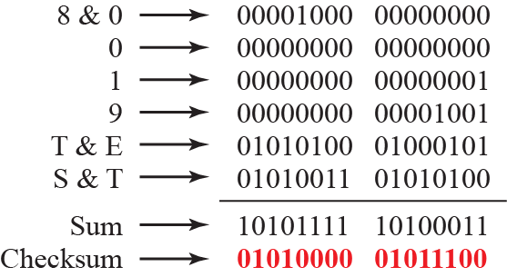
Figure 19.11: Example of checksum calculation
19.38
Notes:
19.#

Slide 39
19-3 MOBILE IP
In the last section of this chapter, we discuss mobile IP. As mobile and personal computers such as notebooks become increasingly popular, we need to think about mobile IP, the extension of IP protocol that allows mobile computers to be connected to the Internet at any location where the connection is possible. In this section, we discuss this issue.
19.39
Notes:
19.#

Slide 40
19.3.1 Addressing
The main problem that must be solved in providing mobile communication using the IP protocol is addressing.
19.40
Notes:
19.#

Slide 41
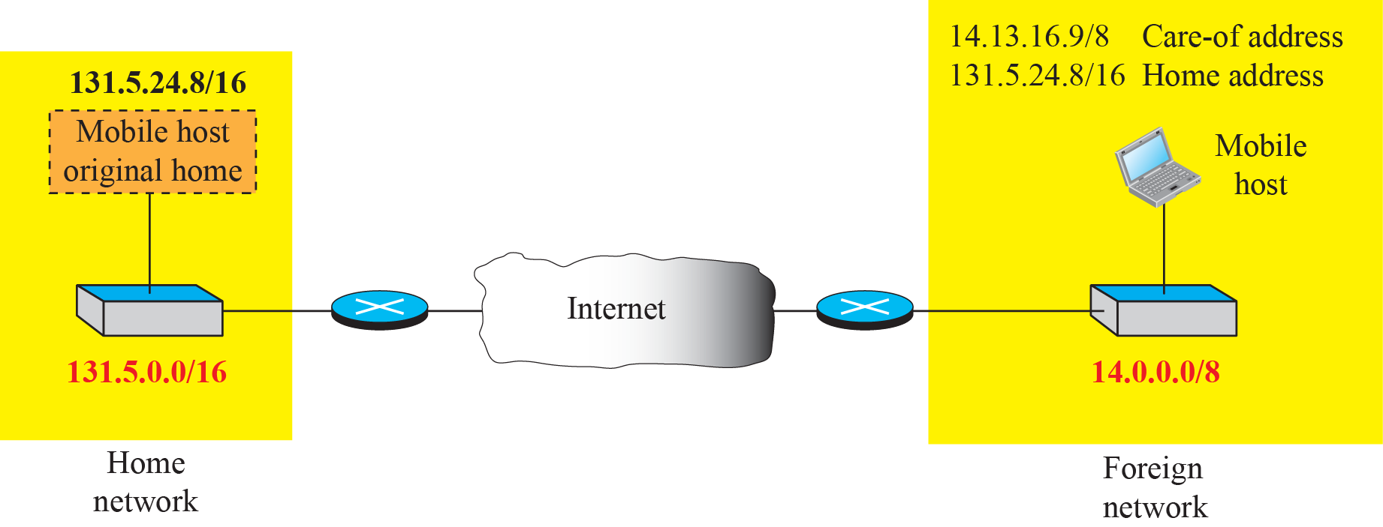
Figure 19.12: Home address and care-of address
19.41
Notes:
19.#

Slide 42
19.3.2 Agents
To make the change of address transparent to the rest of the Internet requires a home agent and a foreign agent. Figure 19.13 shows the position of a home agent relative to the home network and a foreign agent relative to the foreign network..
19.42
Notes:
19.#

Slide 43
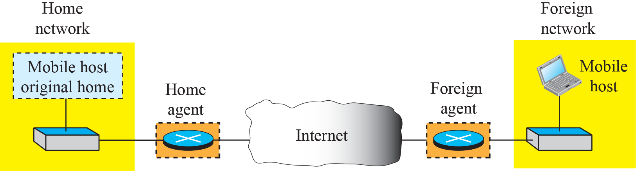
Figure 19.13: Home agent and foreign agent
19.43
Notes:
19.#

Slide 44
19.3.3 Three Phases
To communicate with a remote host, a mobile host goes through three phases: agent discovery, registration, and data transfer, as shown in Figure 19.14.
19.44
Notes:
19.#

Slide 45
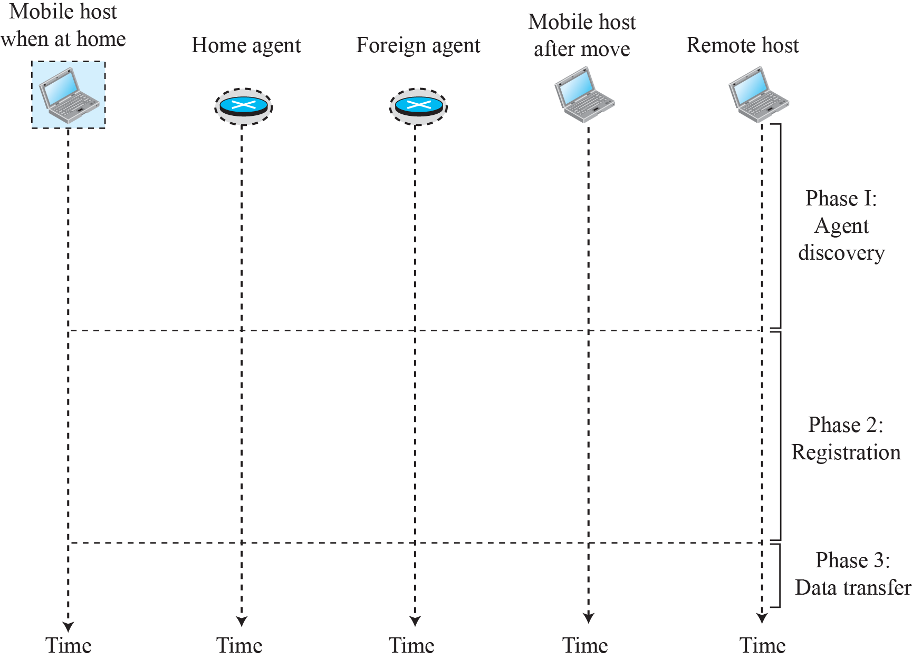
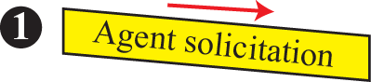

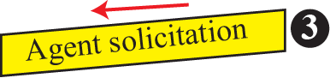






Figure19.14: Remote host and mobile host communication
19.45
Notes:
19.#

Slide 46
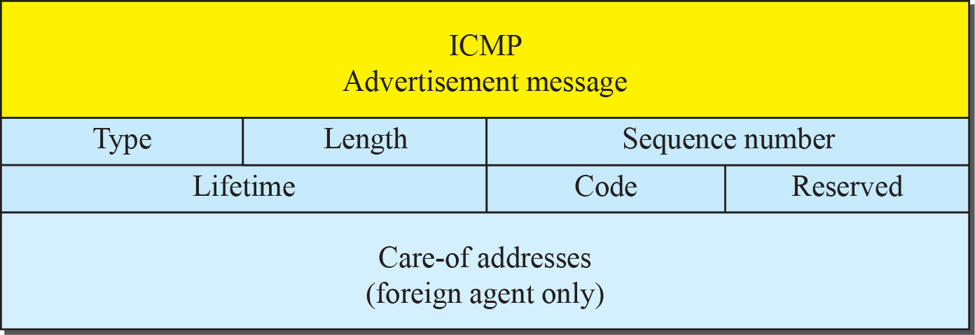
Figure 19.14: Agent advertisement
19.46
Notes:
19.#

Slide 47
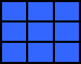
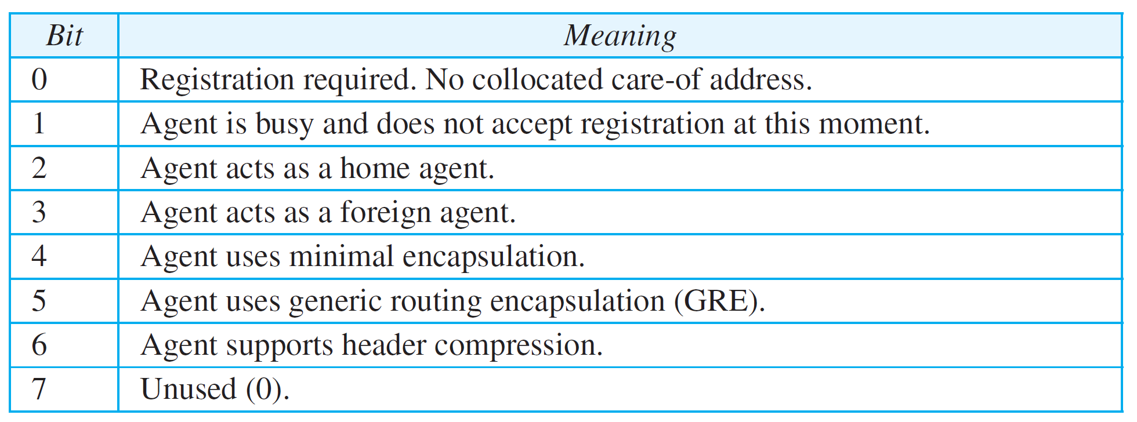
Table 19.1: Code Bits
19.47
Notes:
47

Slide 48
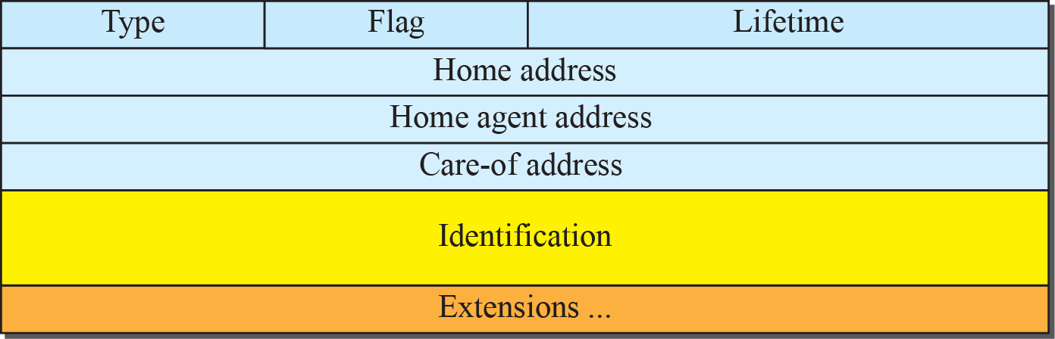
Figure 19.16: Registration request format
19.48
Notes:
19.#

Slide 49
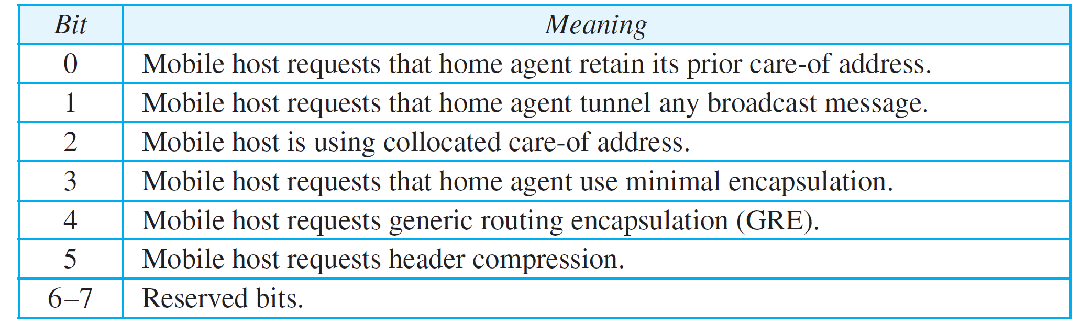
Table 19.2: Registration request flag field bits
19.49
Notes:
49

Slide 50
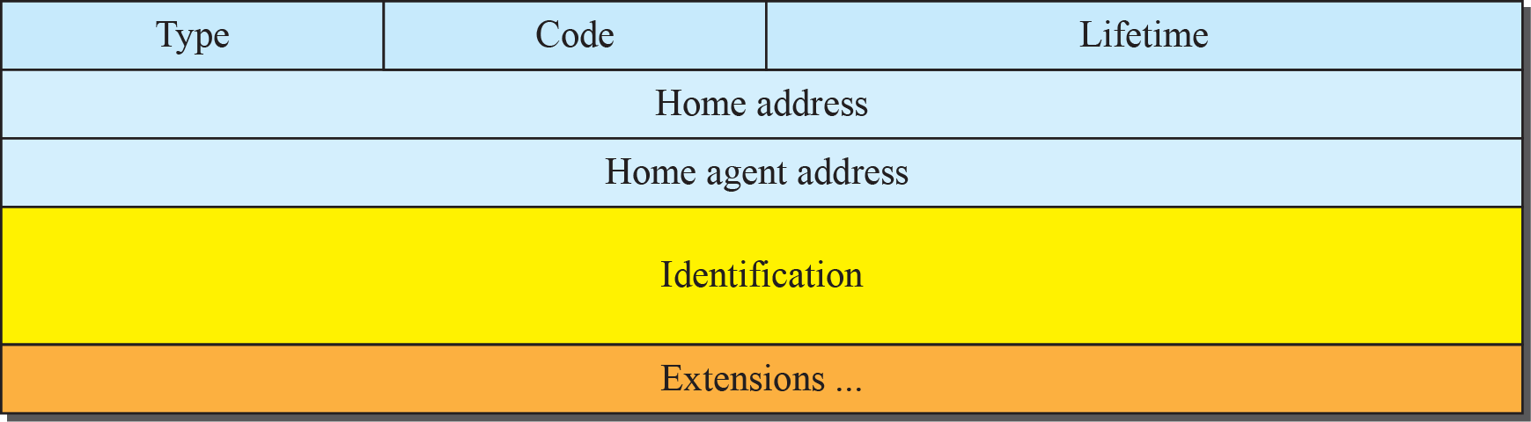
Figure 19,17: Registration reply format
19.50
Notes:
19.#

Slide 51
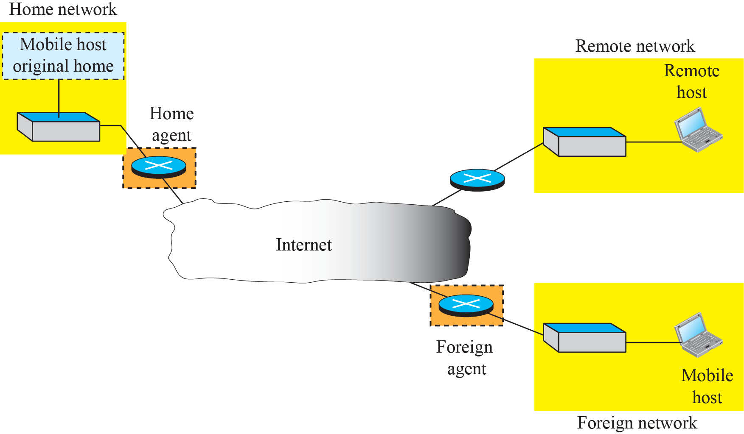
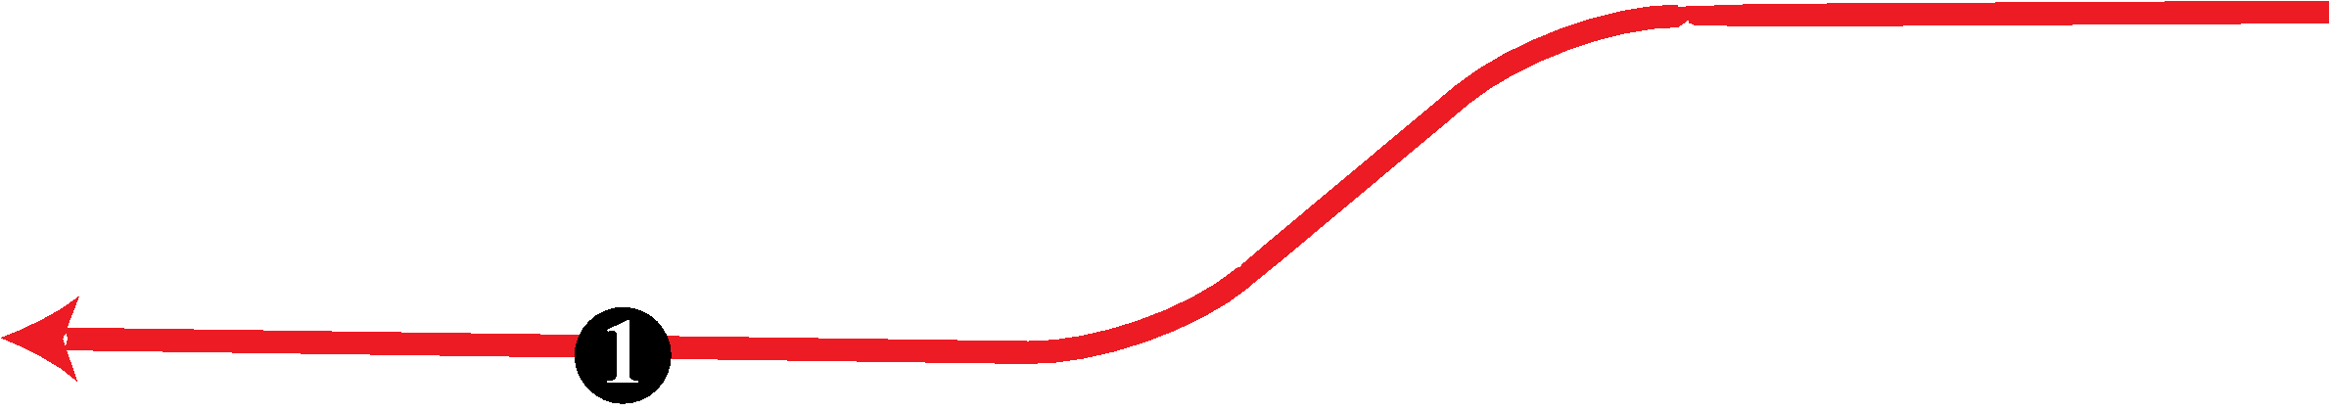
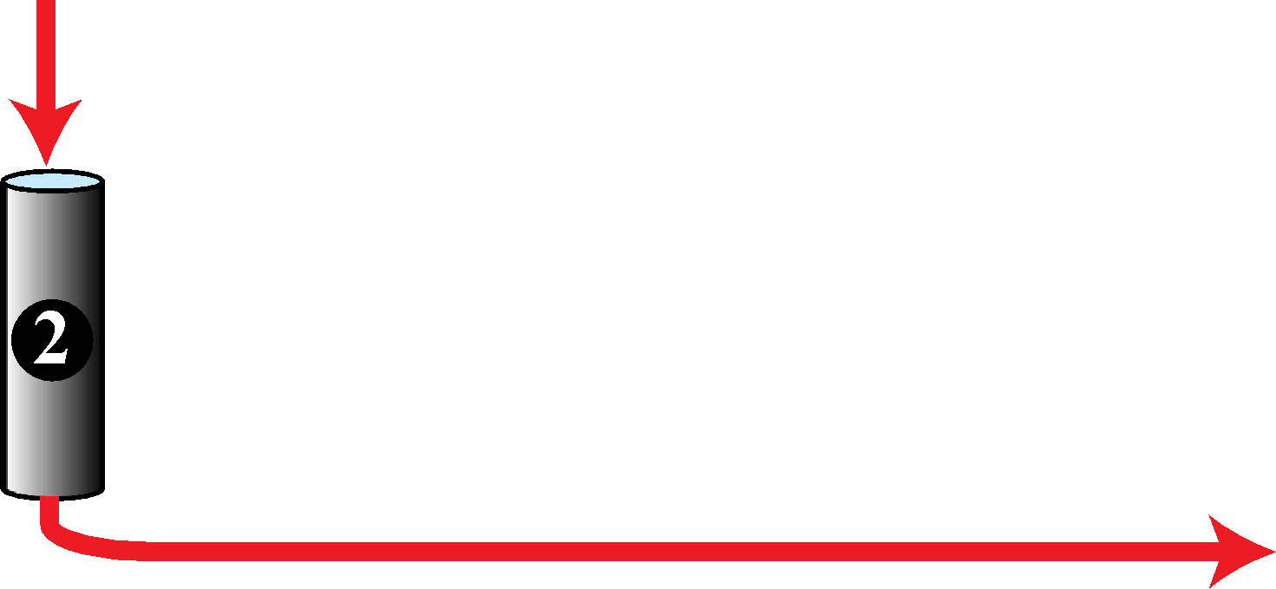

Figure 19.18: Data transfer
19.51
Notes:
19.#

Slide 52
19.3.4 Inefficiency in Mobile IP
Communication involving mobile IP can be inefficient. The inefficiency can be severe or moderate. The severe case is called double crossing or 2X. The moderate case is triangle routing or dog-leg routing.
19.52
Notes:
19.#

Slide 53
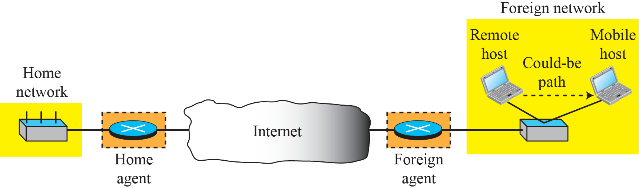

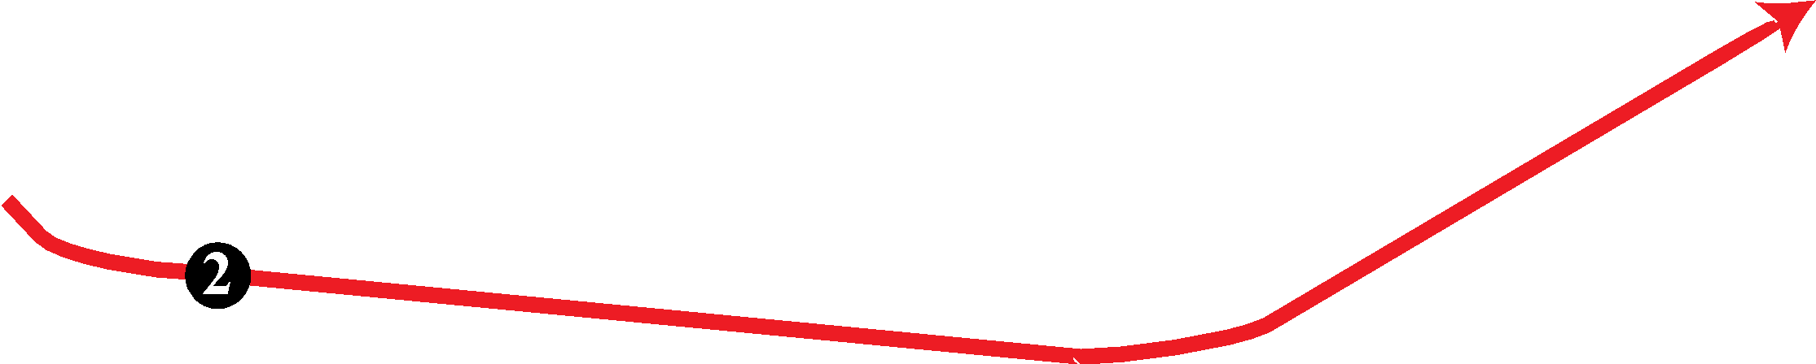
Figure 19.19: Double crossing
19.53
Notes:
19.#

Slide 54
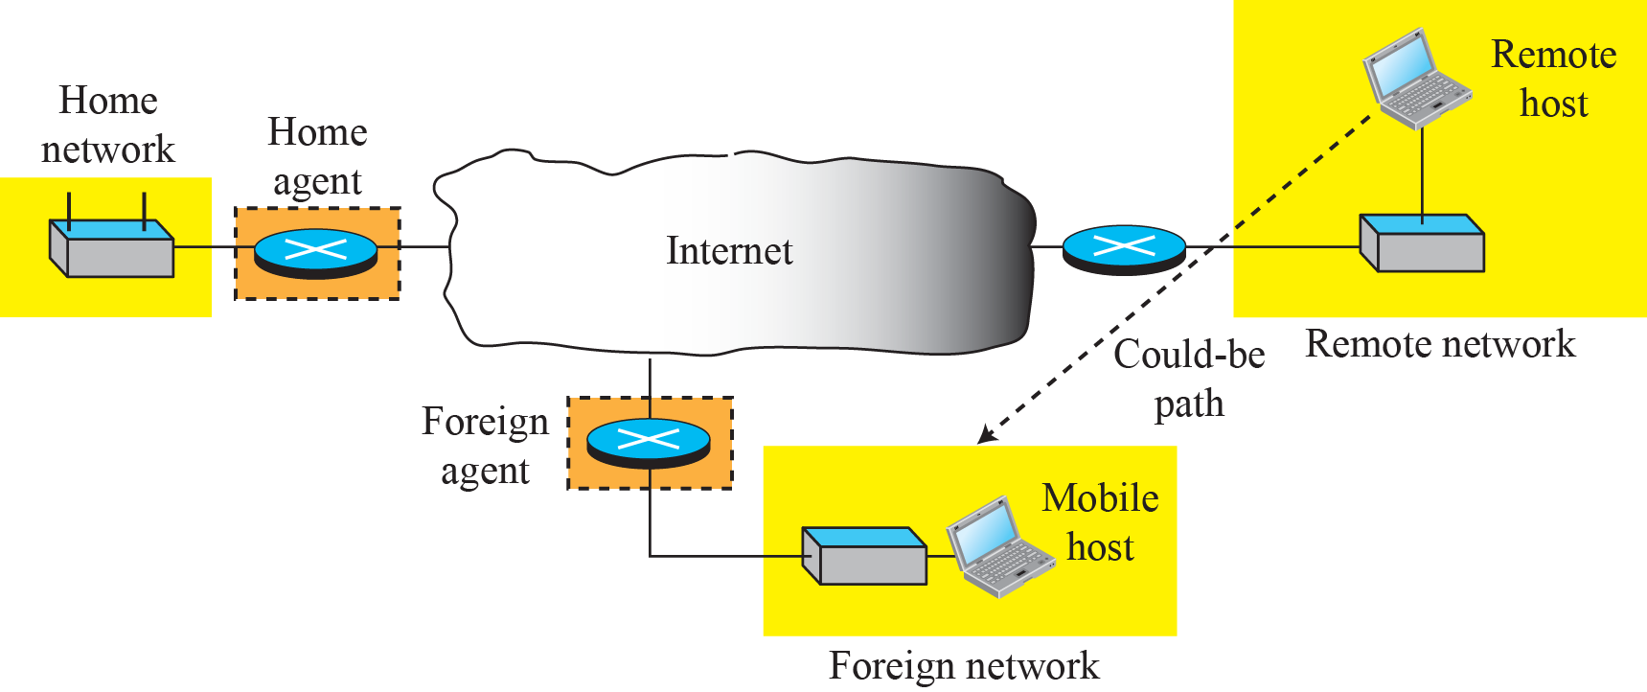


Figure 19.20: Triangle routing
19.54
Notes:
19.#

